Slide 1
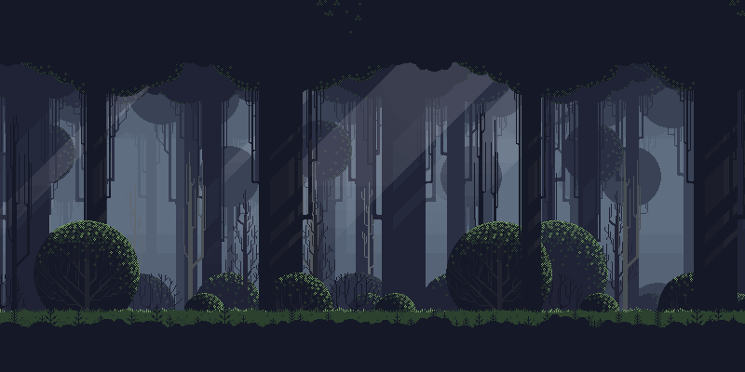





UNDER MAINTENANCE
POWERED BY:

Slide 2
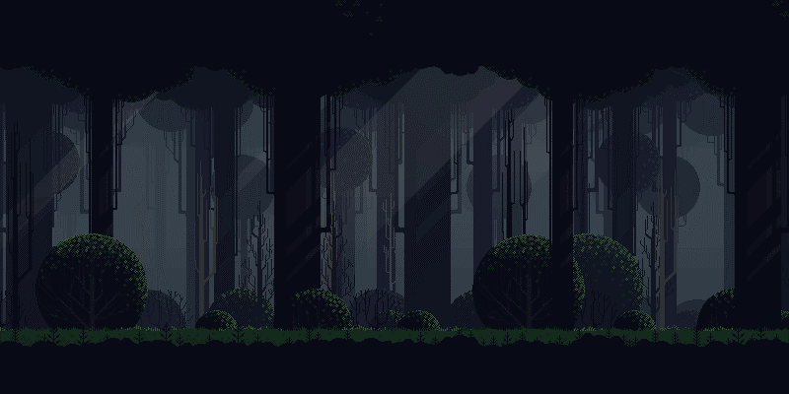
MAIN MENU
OUR TEAM:
KEVIN SIMORANGKIR
FERREYLA SETARA IBN
IGNATIUS KRISNA ISSAPUTRA
M. RIZKI ALFAINA
RIZKA FAUZIYAH
NUR HIKMAH JULIYANTI
POWERED BY:

Slide 3
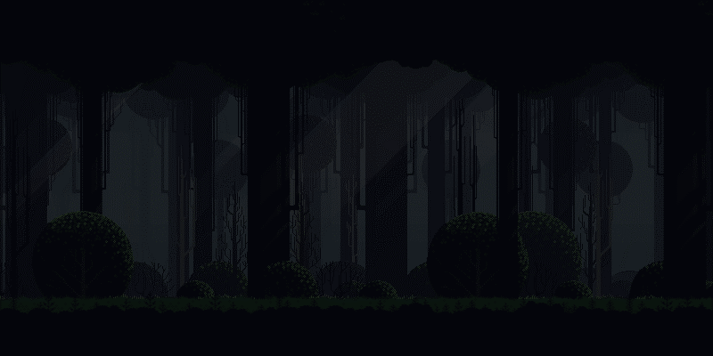

MAIN MENU
Dalam game ini, kami menghadirkan pengalaman permainan yang menggabungkan elemen grafis pixelated dengan sistem pertarungan turn based. Karakter utama dalam game ini akan berhadapan dengan sejumlah musuh yang harus dilawan secara bergantian.
POWERED BY:

Slide 4


MAIN MENU
Baik pemain maupun musuh akan memiliki basic attack yang mengurangi health point. Namun, tidak hanya basic attack, terdapat kemampuan heal menggunakan potion. Namun, penting untuk dicatat bahwa potion yang tersedia dalam game ini memiliki jumlah yang terbatas, sehingga pemain harus mengelola penggunaannya dengan bijak.
POWERED BY:

Slide 5

MAIN MENU
UML CLASS DIAGRAM
POWERED BY:

Slide 6
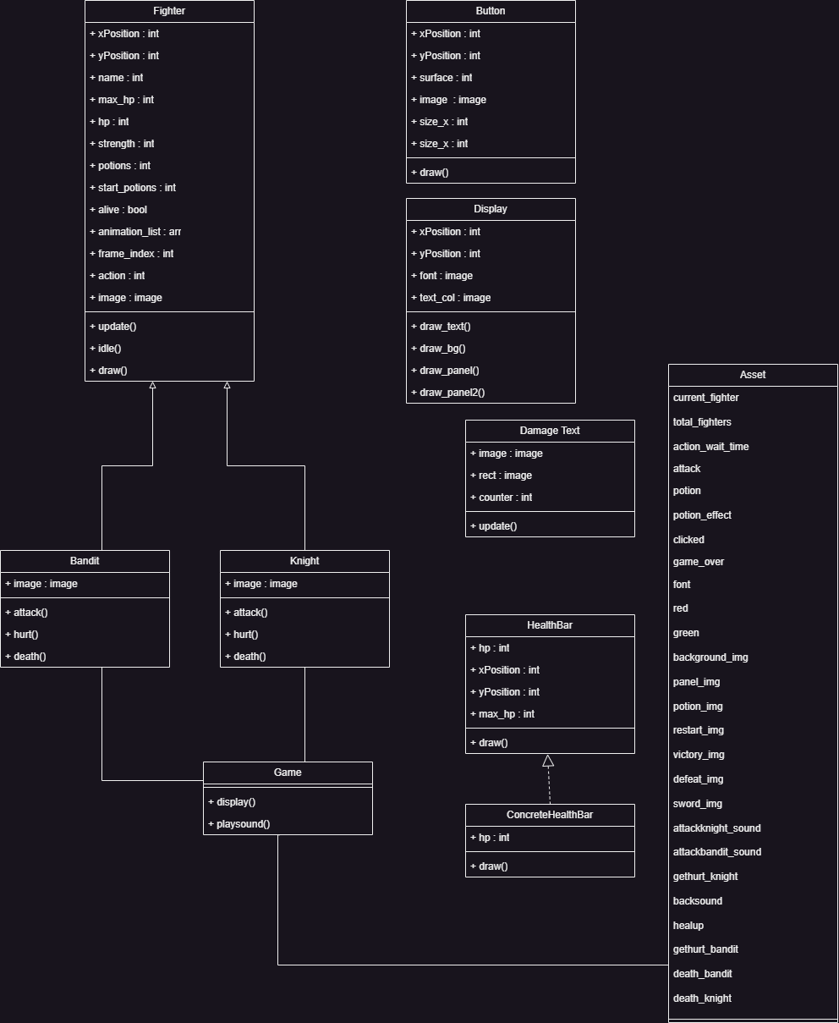
POWERED BY:

Slide 7
POWERED BY:

Slide 8
POWERED BY:

Slide 9

MAIN MENU
PROGRAM PREVIEW
POWERED BY:

Slide 10
Bagian ini merupakan pendeklarasian gambar latar pada game ini pada modul ”Enemy_Hero”
pygame.init()
clock = pygame.time.Clock()
fps = 60
#game window
bottom_panel = 150
screen_width = 800
screen_height = 400 + bottom_panel
screen = pygame.display.set_mode((screen_width, screen_height))
pygame.display.set_caption('Battle')
#create function for drawing text
def draw_text(text, font, text_col, x, y):
img = font.render(text, True, text_col)
screen.blit(img, (x, y))
POWERED BY:

Slide 11
Bagian ini merupakan pendeklarasian gambar latar pada game ini pada modul ”Enemy_Hero”
#function for drawing background
def draw_bg():
screen.blit(asset.background_img, (0, 0))
#function for drawing panel
def draw_panel():
#draw panel rectangle
screen.blit(asset.panel_img, (0, screen_height - bottom_panel))
#show knight stats
draw_text(f'{knight.name} HP: {knight.hp}', asset.font, asset.red, 100, screen_height - bottom_panel + 10)
for count, i in enumerate(bandit_list):
#show name and health
draw_text(f'{i.name} HP: {i.hp}', asset.font, asset.red, 550, (screen_height - bottom_panel + 10) + count * 60)
POWERED BY:

Slide 12
Setelah pendeklarasian objek, maka termasuk pendeklarasian image attack, idle, death, dan hurt
for i in range(8):
img = pygame.image.load(f'img/{self.name}/Idle/{i}.png')
img = pygame.transform.scale(img, (img.get_width() * 3, img.get_height() * 3))
temp_list.append(img)
self.animation_list.append(temp_list)
# load attack images
temp_list = []
for i in range(8):
img = pygame.image.load(f'img/{self.name}/Attack/{i}.png')
img = pygame.transform.scale(img, (img.get_width() * 3, img.get_height() * 3))
temp_list.append(img)
self.animation_list.append(temp_list)
# load hurt images
temp_list = []
for i in range(3):
img = pygame.image.load(f'img/{self.name}/Hurt/{i}.png')
POWERED BY:

Slide 13
Setelah pendeklarasian objek, maka termasuk pendeklarasian image attack, idle, death, dan hurt
img = pygame.transform.scale(img, (img.get_width() * 3, img.get_height() * 3))
temp_list.append(img)
self.animation_list.append(temp_list)
# load death images
temp_list = []
for i in range(10):
img = pygame.image.load(f'img/{self.name}/Death/{i}.png')
img = pygame.transform.scale(img, (img.get_width() * 3, img.get_height() * 3))
temp_list.append(img)
self.animation_list.append(temp_list)
self.image = self.animation_list[self.action][self.frame_index]
self.rect = self.image.get_rect()
self.rect.center = (x, y)
POWERED BY:

Slide 14
Pendeklarasian pengurangan darah dan efek suara pada method diatas
def attack(self, target):
# deal damage to enemy
rand = random.randint(-5, 5)
damage = self.strength + rand
target.hp -= damage
# run enemy hurt animation
target.hurt()
asset.attackbandit_sound.play()
# check if target has died
if target.hp < 1:
target.hp = 0
target.alive = False
target.death()
damage_text = DamageText(target.rect.centerx, target.rect.y, str(damage), asset.red)
damage_text_group.add(damage_text)
# set variables to attack animation
self.action = 1
self.frame_index = 0
self.update_time = pygame.time.get_ticks()
POWERED BY:

Slide 15
Pendeklarasian pengurangan darah dan efek suara pada method diatas
def hurt(self):
# set variables to hurt animation
self.action = 2
asset.gethurt_bandit.play()
self.frame_index = 0
self.update_time = pygame.time.get_ticks()
def death(self):
# set variables to death animation
self.action = 3
asset.death_bandit.play()
self.frame_index = 0
self.update_time = pygame.time.get_ticks()
def reset(self):
self.alive = True
self.potions = self.start_potions
self.hp = self.max_hp
self.frame_index = 0
self.action = 0
self.update_time = pygame.time.get_ticks()
POWERED BY:

Slide 16
Healthbar dan damage text sebagai add on
apabila terjadi penambahan darah pada potion dan jika terkena hit
lass HealthBar(ABC):
def __init__(self, x, y, hp, max_hp):
self.x = x
self.y = y
self.hp = hp
self.max_hp = max_hp
@abstractmethod
def draw(self, hp):
pass
class ConcreteHealthBar(HealthBar):
def draw(self, hp):
# update with new health
self.hp = hp
# calculate health ratio
ratio = self.hp / self.max_hp
pygame.draw.rect(screen, asset.red, (self.x, self.y, 150, 20))
pygame.draw.rect(screen, asset.green, (self.x, self.y, 150 * ratio, 20))
POWERED BY:

Slide 17
Healthbar dan damage text sebagai add on
apabila terjadi penambahan darah pada potion dan jika terkena hit
class DamageText(pygame.sprite.Sprite):
def __init__(self, x, y, damage, colour):
pygame.sprite.Sprite.__init__(self)
self.image = asset.font.render(damage, True, colour)
self.rect = self.image.get_rect()
self.rect.center = (x, y)
self.counter = 0
def update(self):
# move damage text up
self.rect.y -= 1
# delete the text after a few seconds
self.counter += 1
if self.counter > 30:
self.kill()
POWERED BY:

Slide 18
Pemanggilan fungsi untuk ditampilkan pada layar
damage_text_group = pygame.sprite.Group()
asset = asset.Game()
knight = Knight(200, 260, 'Knight', 30, 10, 3)
bandit1 = Bandit(550, 270, 'Bandit', 20, 6, 1)
bandit2 = Bandit(700, 270, 'Bandit', 20, 6, 1)
bandit3 = Bandit(400, 270, 'Bandit', 20, 6, 1)
bandit_list = []
bandit_list.append(bandit1)
bandit_list.append(bandit2)
bandit_list
POWERED BY:

Slide 19
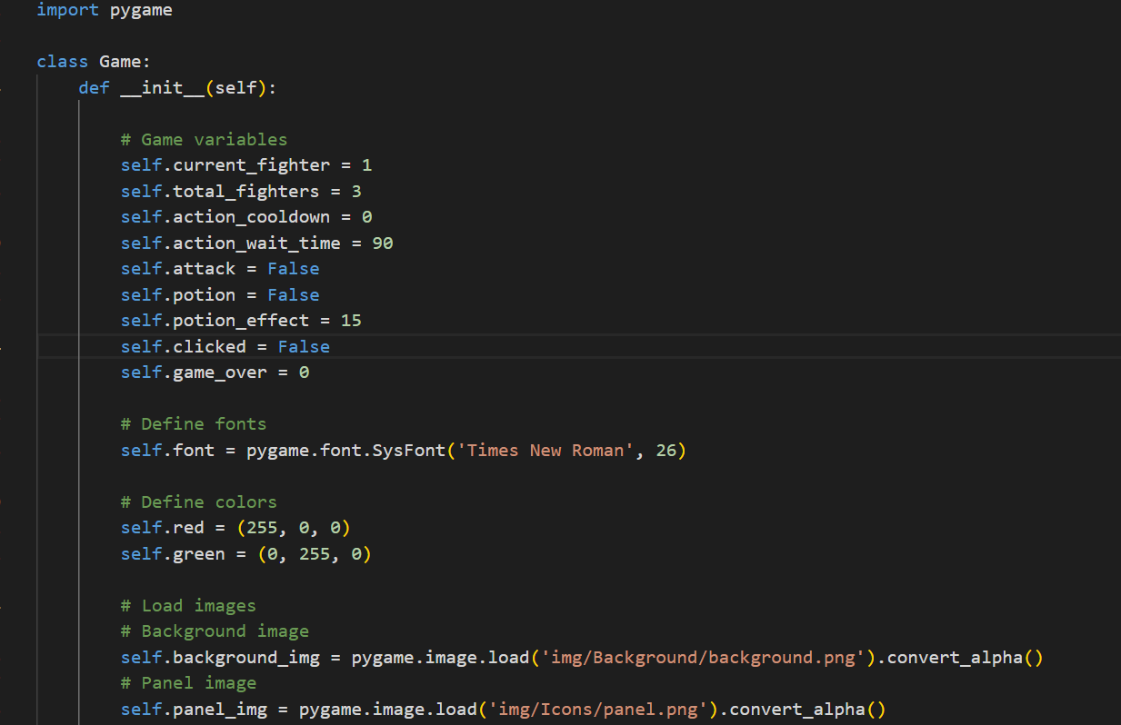
asset sound dan proses dalam gambar game disimpan di module asset class game
POWERED BY:

Slide 20
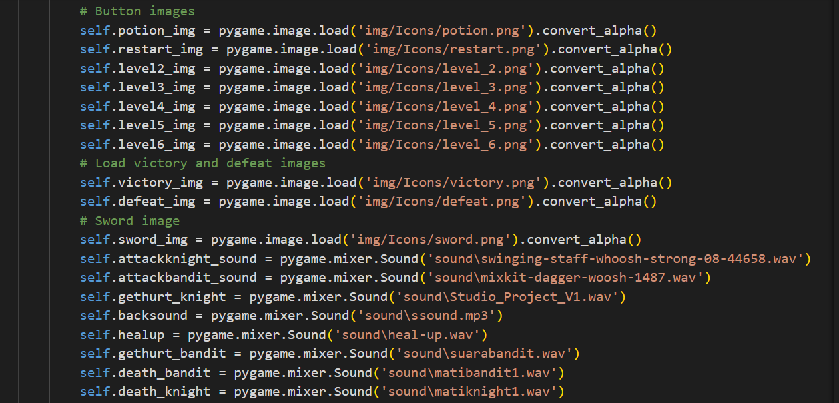
asset sound dan proses dalam gambar game disimpan di module asset class game
POWERED BY:

Slide 21
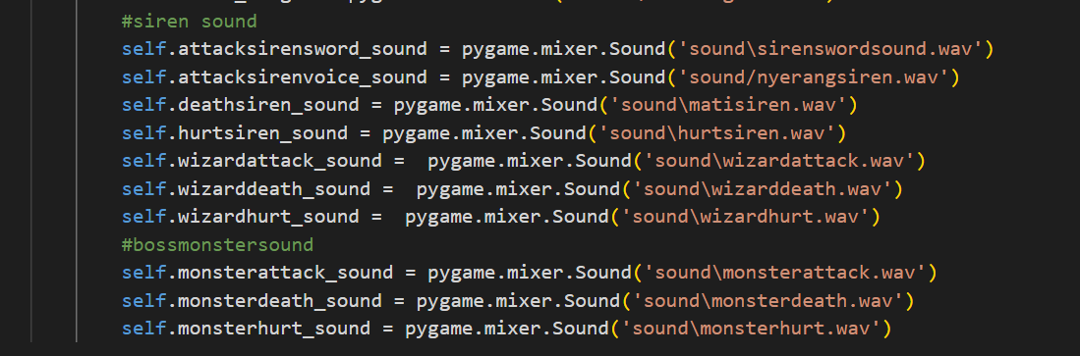
asset sound dan proses dalam gambar game disimpan di module asset class game
POWERED BY:

Slide 22
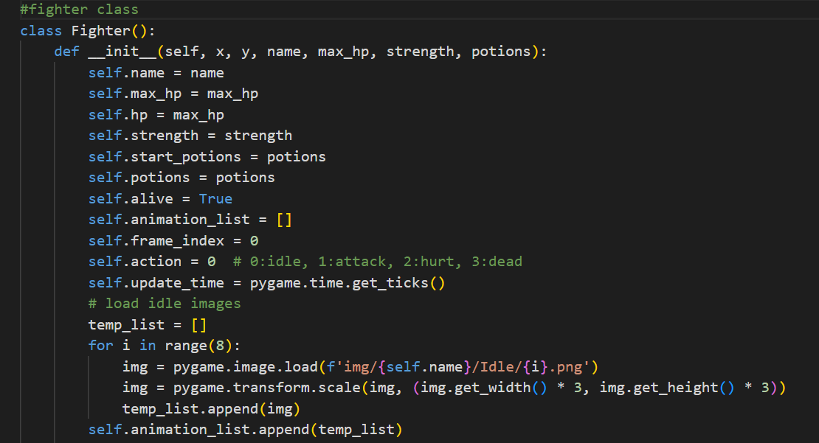
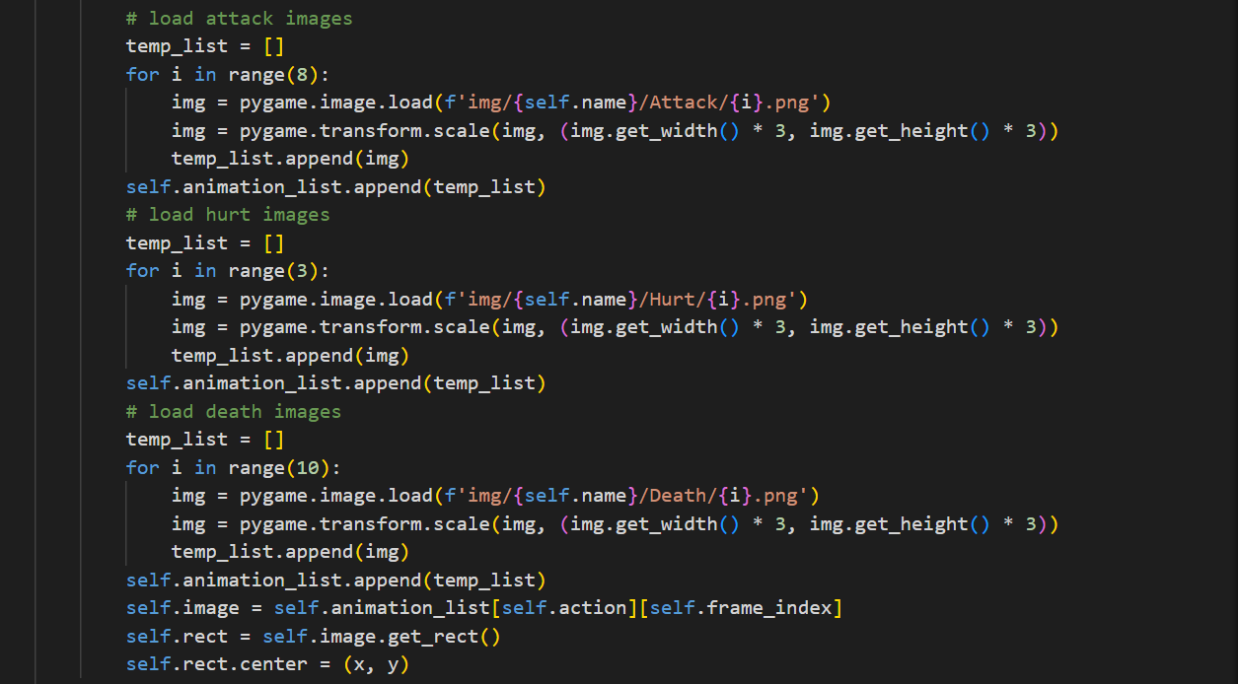
Proses pergerakan gambar karakter dan aksinya
POWERED BY:

Slide 23
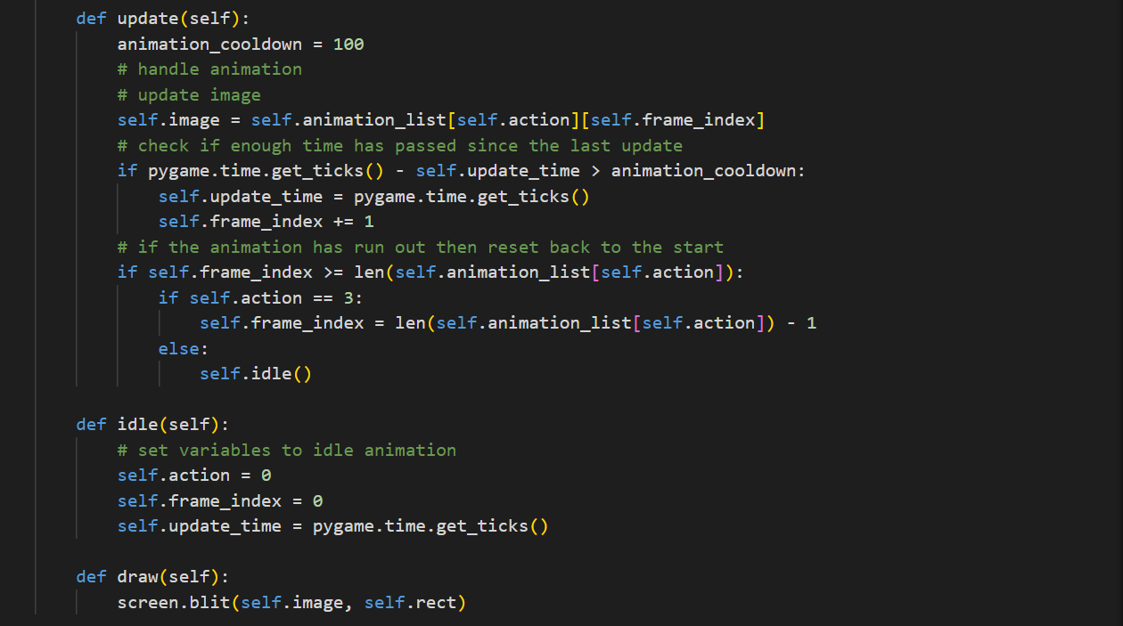
Proses pergerakan gambar karakter dan aksinya
POWERED BY:

Slide 24
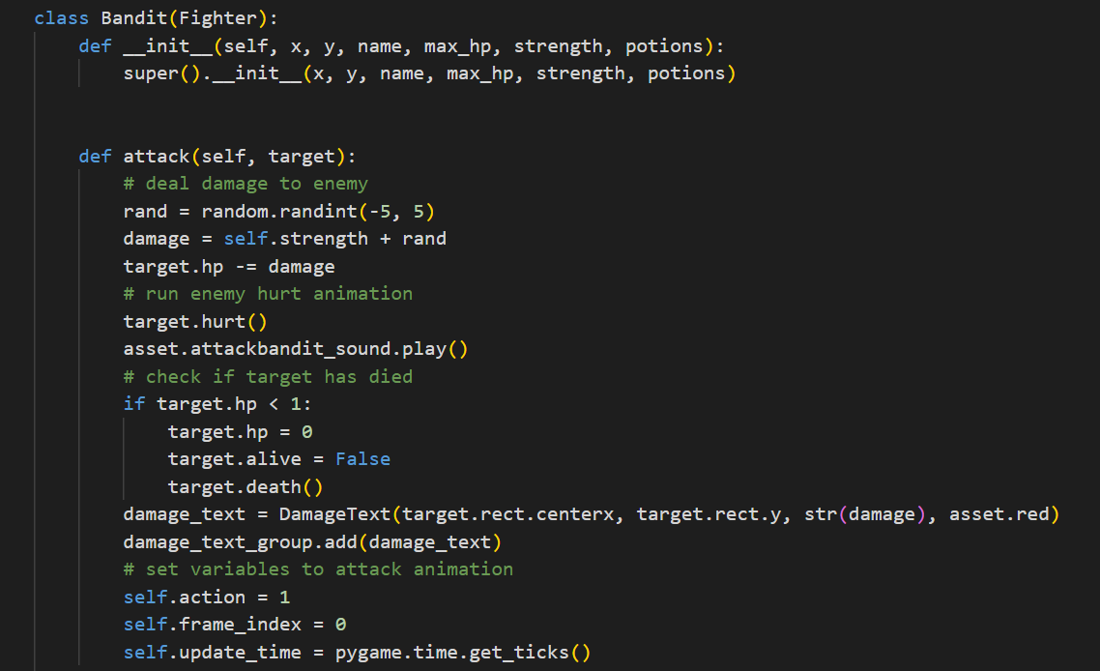
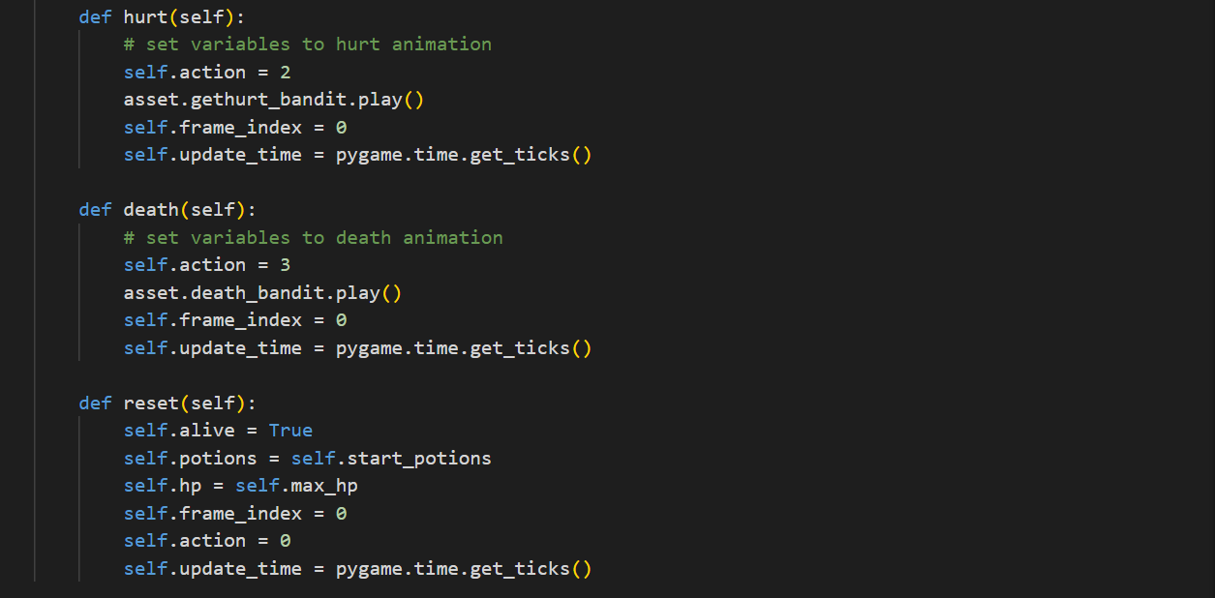
Proses pergerakan gambar karakter dan aksinya
(Class Bandit)
POWERED BY:

Slide 25
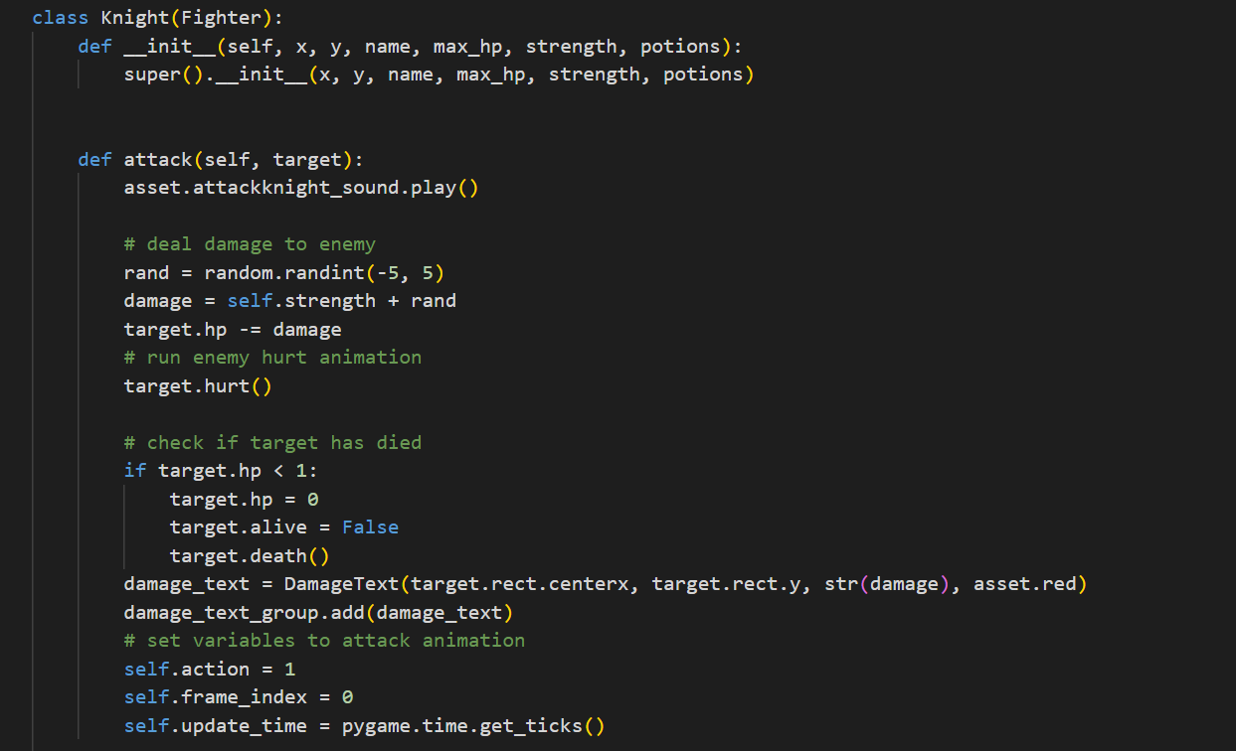
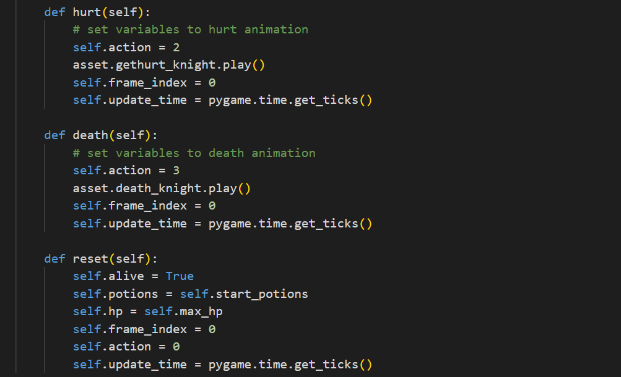
Proses pergerakan gambar karakter dan aksinya
(Class Siren)
POWERED BY:

Slide 26
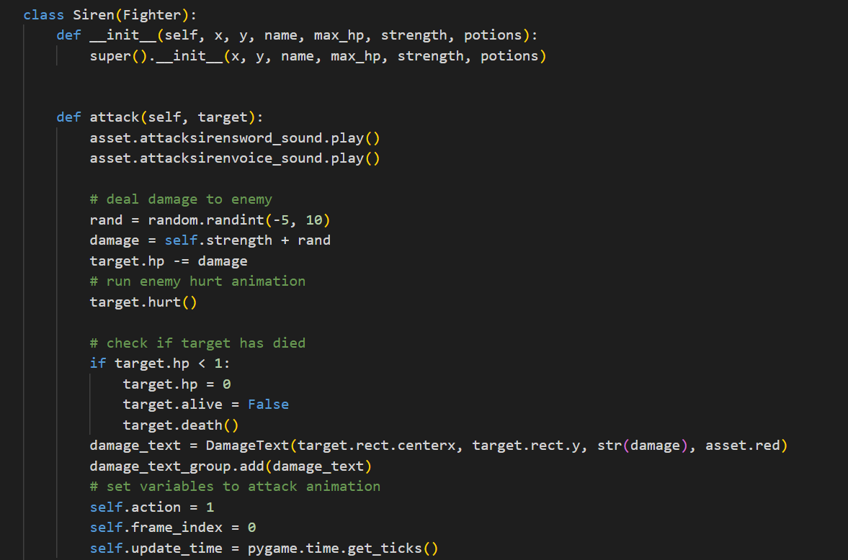
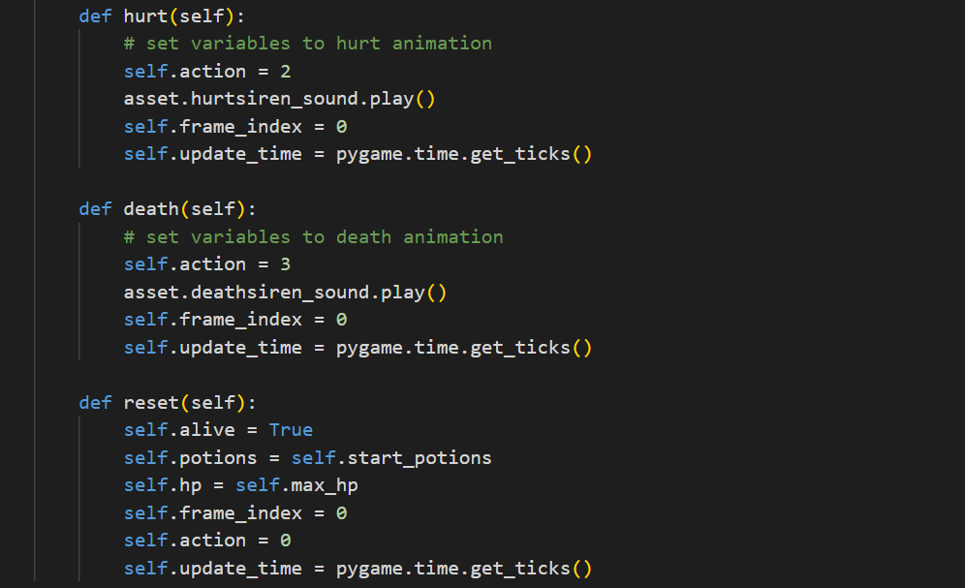
Proses pergerakan gambar karakter dan aksinya
(Class Siren)
POWERED BY:

Slide 27
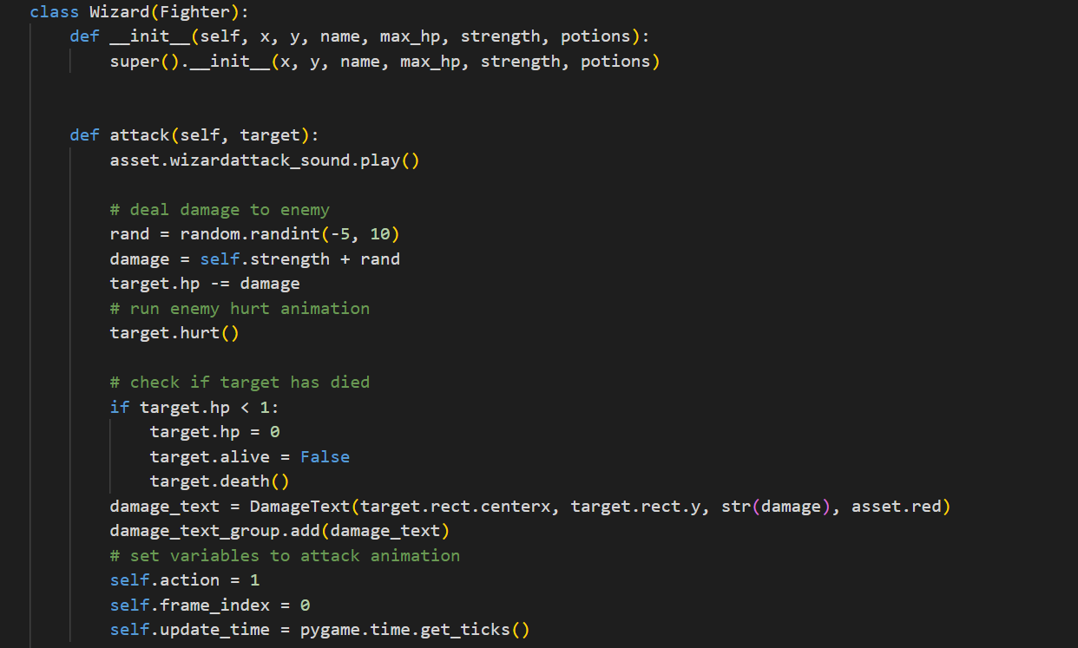
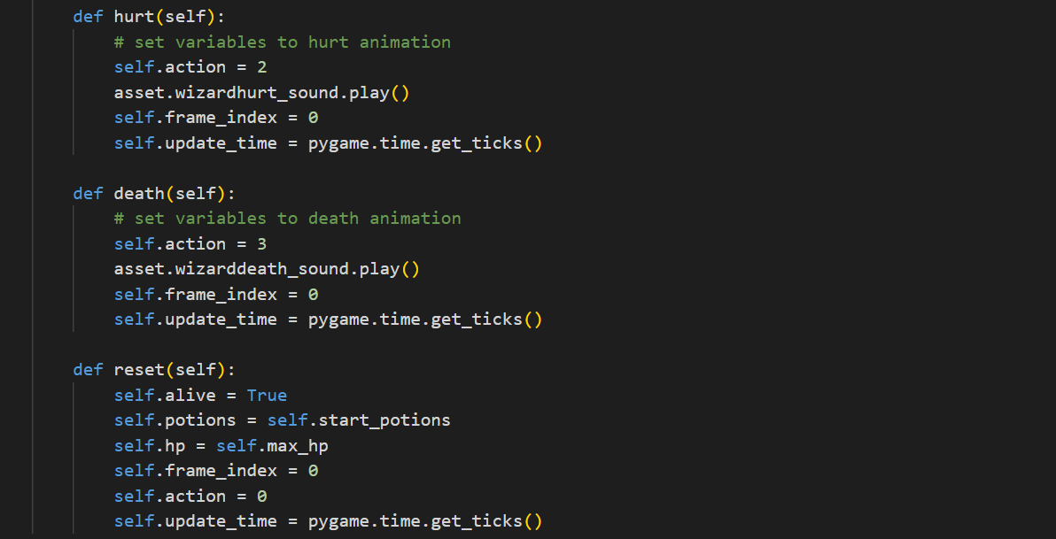
Proses pergerakan gambar karakter dan aksinya
(Class Wizard)
POWERED BY:

Slide 28
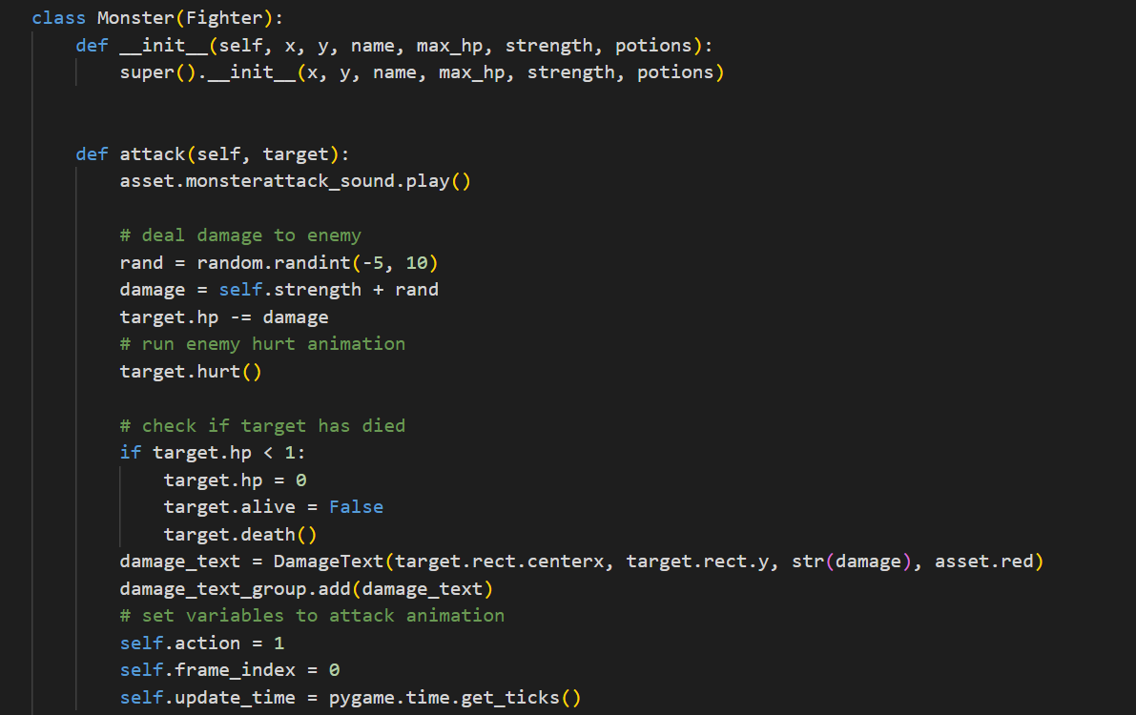
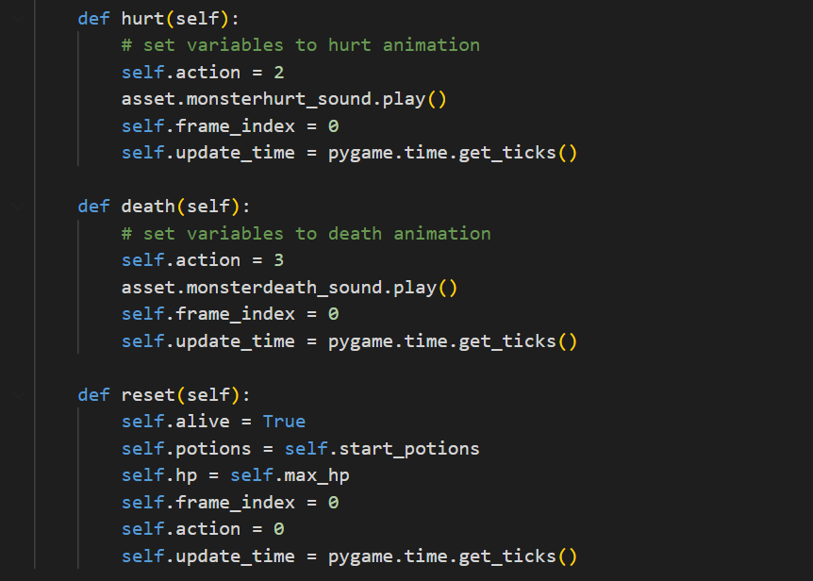
Proses pergerakan gambar karakter dan aksinya
(Class Monster)
POWERED BY:

Slide 29
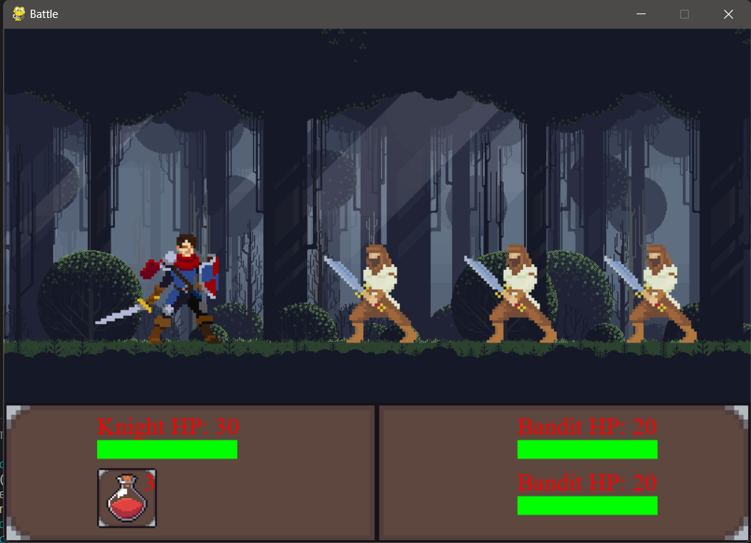
PREVIEW INGAME
MAIN MENU

Slide 30
POWERED BY:

